Slide 1
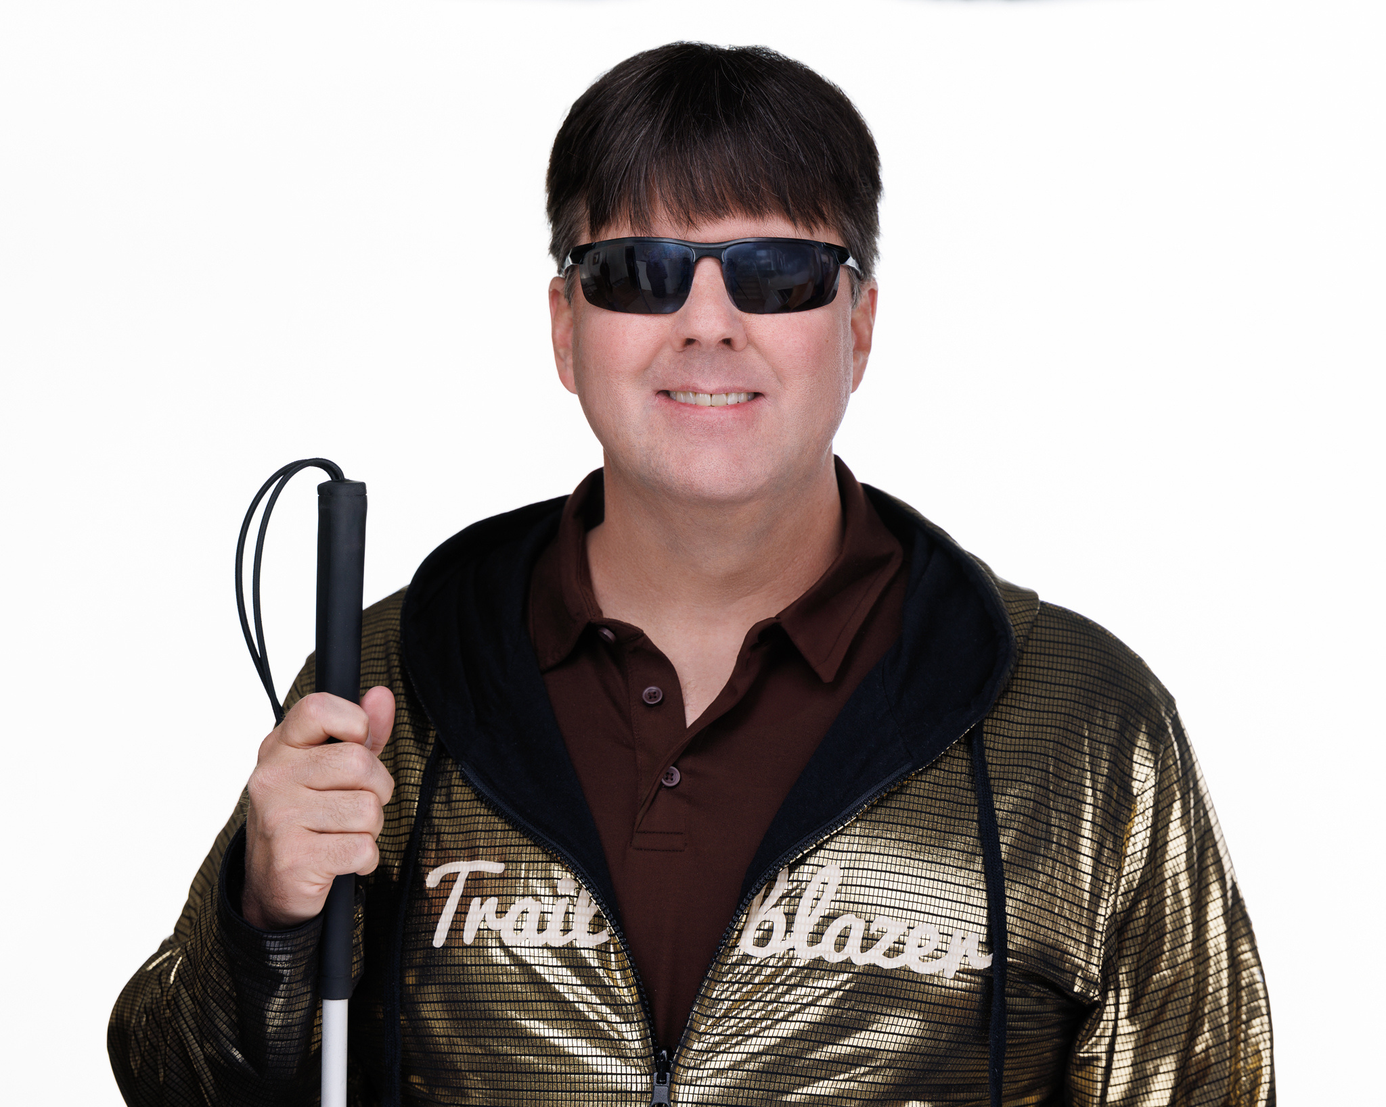

Breaking Barriers, Building Futures:
How BIT’s Registered Apprenticeship Program Empowers Talent with Disabilities
Blind Institute of Technology (BIT) is a global nonprofit advancing workforce equity by training and connecting skilled professionals with disabilities to competitive tech careers. BIT is the only Salesforce-approved training provider for professionals with disabilities.
Presented by Mike Hess, Founder & Executive Director

Slide 2


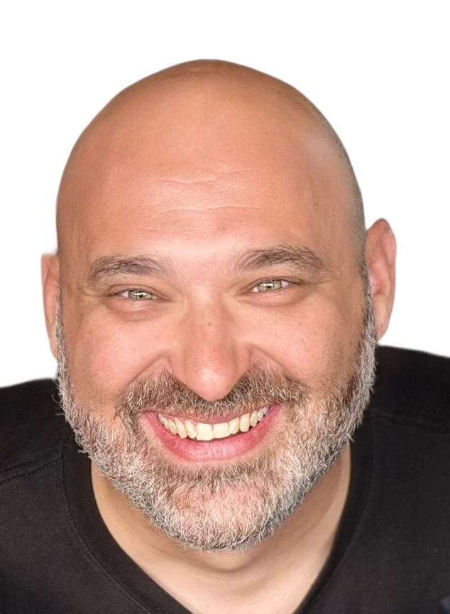
Elliott Natale Director of BIT Academy
Elliott serves as Academy Director at Blind Institute of Technology, where he leads training programs that prepare professionals with disabilities for technology careers. With more than 15 years of experience across IT, education, and accessibility, he is passionate about using technology to remove barriers, build confidence, and create real-world opportunities for learners.

Slide 3




BIT ACADEMY
BUILDING SKILLS. CREATING CAREERS.
“The Academy is where opportunity begins - it equips professionals with disabilities with in-demand tech skills and then connects them to real, accessible career pathways.” - Elliott Natale, BIT Academy Director
Only Salesforce-approved global training provider for professionals with disabilities
Courses in Digital Accessibility Analysis (CPACC), Salesforce Administration, Platform App Builder, Agentforce, and Business Analyst
Fully subsidized and fully accessible online training led by certified instructors with lived experience
Pathway from
learning → certification → paid apprenticeships → competitive employment

Slide 4
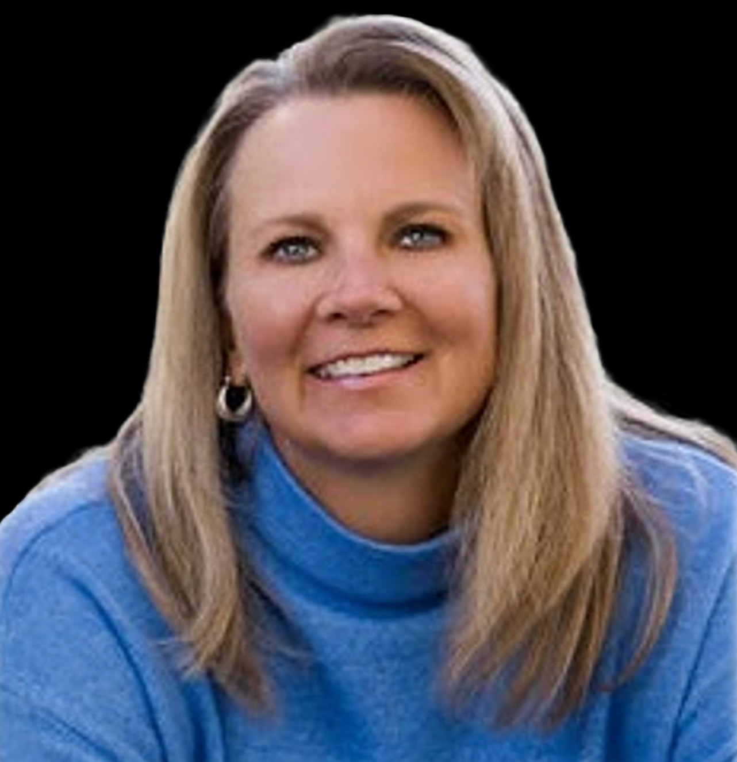
Kristy Schenderlein VP of Operations
Kristy Schenderlein oversees day-to-day operations and strategic initiatives at BIT. A blind professional with a background in defense litigation and small-business leadership, Kristy brings deep experience in operations, HR, and advocacy. She is passionate about advancing employment opportunities for professionals with disabilities and helping employers recognize the value of disability talent.

Slide 5




DIF GRANT & APPRENTICESHIP EXPANSION SCALING IMPACT NATIONWIDE
“This grant allows us to scale apprenticeships nationwide - accelerating BIT’s mission while proving that technology can be the great equalizer.” – Mike Hess, BIT Founder/Executive Director
$8M Disability Innovation Fund (DIF) grant from U.S. Dept. of Education
Expanding our U.S. Department of Labor Registered Apprenticeship Program
Creating competitive integrated employment (CIE) opportunities across the nation
Partnering with employers to open more doors than ever before

Slide 6

Dustin Lewis BIT Salesforce Apprentice
Dustin Lewis is a certified Salesforce Administrator and Apprentice with BIT. Born with blue cone monochromatism, he brings both lived experience and technical expertise to his work. At BIT, he supports organizations through Salesforce consulting, configuration, automation, and system design, helping them get more value from their platforms. Dustin is passionate about building a meaningful long-term career in tech and using technology to solve real-world challenges.

Slide 7





Why Partner with BIT
Expand Career Pathways: Open doors for professionals with disabilities to thrive in high-growth tech roles, while building a more innovative workforce.
Amplify Your Impact: Enhance your workforce programs with BIT’s Academy-to-Apprenticeship pipeline, delivering trained, vetted, and placement-ready talent.
Gain Certified, Job-Ready Talent: Our graduates hold industry-recognized certifications and real-world experience, making them an immediate asset to your organization.
We Live It Ourselves: BIT is powered by a team comprised almost entirely of professionals with disabilities.
* BIT is the only Salesforce-approved training provider for people with disabilities, making us uniquely equipped to prepare and connect top talent.

Slide 8


Slide 9







CONTACT US
We'd love to hear from you!
Reach out for inquiries or support:
Email: mike@blindit.org
Phone: 303-995-6453
Website: www.blindit.org
Social:

